Slide 1

Survey Distribution, Bikeshare Station Siting Updates
Hannah DeBruin
Weekly Meeting: Transit Data Subgroup
01/31/22

Slide 2

Survey Distribution
Finalized Qualtrics link and poster will be sent out tomorrow morning (go over posters)
should I put contact information on poster in case questions arise?
Can each agency print off paper forms, stock transit vehicles with pencils, and scan them back into us weekly?
Prairie Five Rides – yes print and scan
Morris Transit – yes print, weekly scanning is a maybe
United Transit – yes print and scan
Papersurvey.io subscription update
Will enter card information with Mackenzie at 3:00
Weekly Meeting (01/31/2023)
Hannah DeBruin

Slide 3
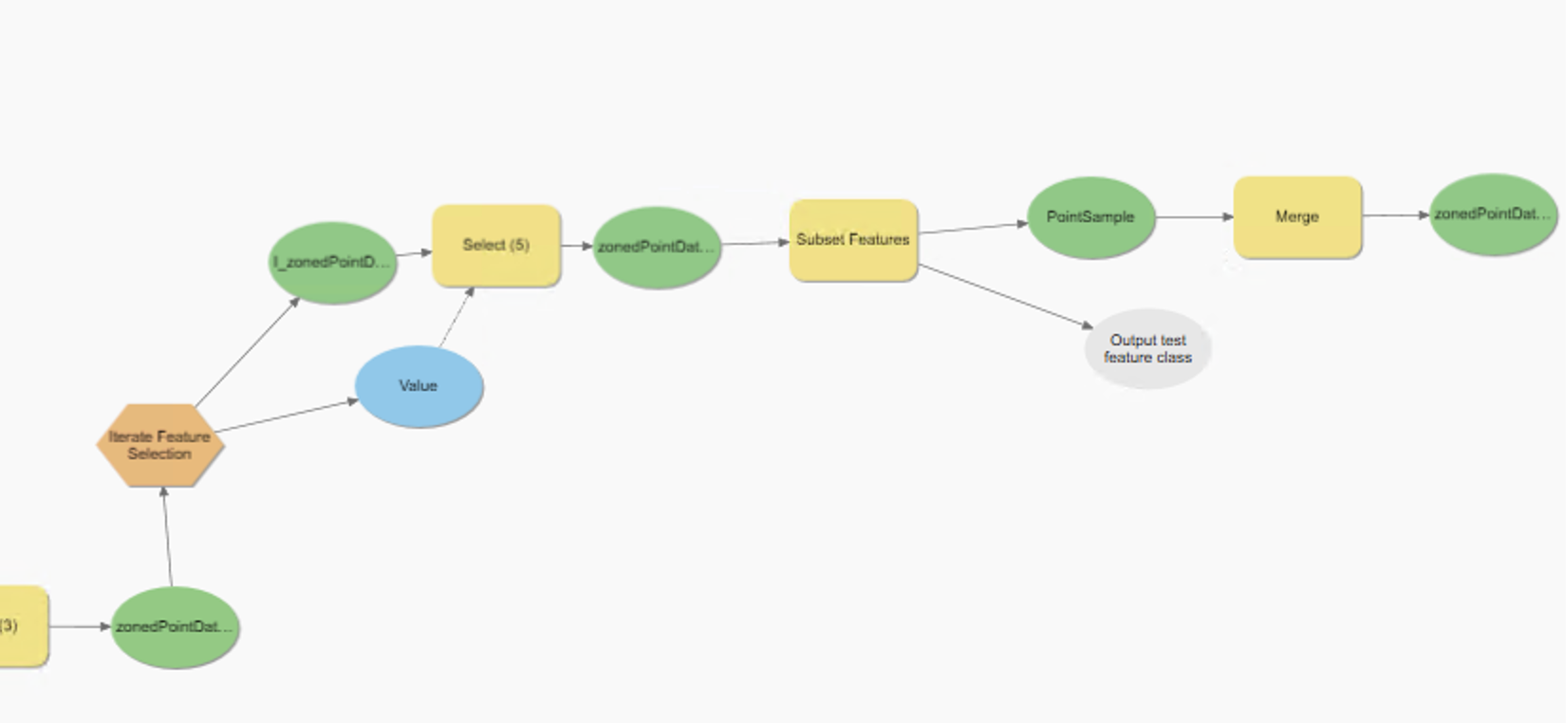
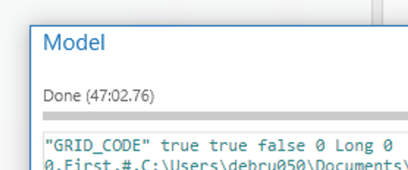
Bikeshare Station Siting
Updates:
Fixed set coverage constraints
Figured out “Iterate Feature Selection” tool that might be ideal for a better sampling by zone method
Currently selecting “above average” points in each zone, randomly selecting 10% of those
What’s Next (Before Friday):
Fix logic – select above 75th percentile instead of (develop python/SQL code inside), no random selection
Determine how to structure iterator so that layers will merge in one run
Weekly Meeting (01/31/2023)
Hannah DeBruin

Slide 4
Bikeshare Station Siting
What’s Next (Before Next Meeting):
“Parameterize” inputs, workspaces, etc to be able to save as a tool in GIS
Explore ITE trip generation numbers as an additional calculation step
Commercial parcels have kilo square feet attached
Households are easy
Start exploring equity metrics (ACS data)
look through and summarize metrics used in existing literature and metrics presented at TRB
look into federal guidance-- I know Met Council has a specific metric for identifying disadvantaged communities
Weekly Meeting (01/31/2023)
Hannah DeBruin

Slide 5
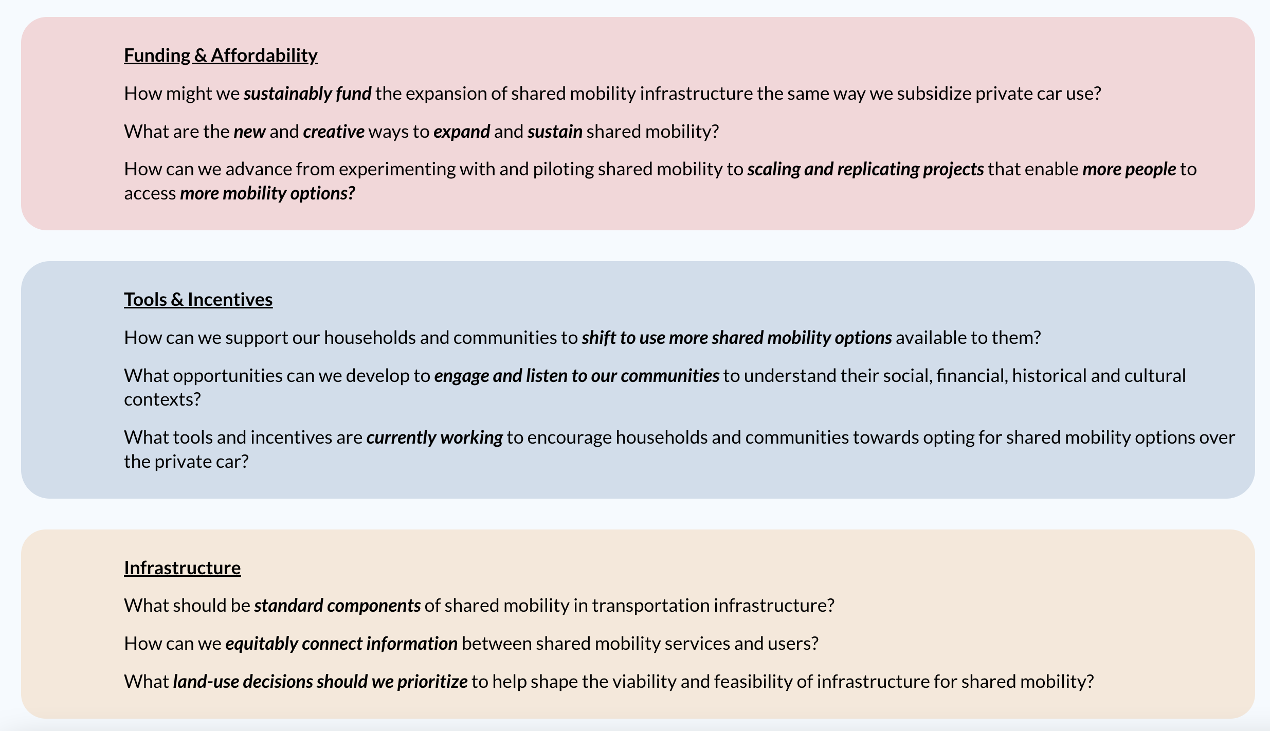


Shared Use Mobility Center 2023 Summit
May 2-4 2023 in Merchandise Mart Plaza, Chicago
Speeches, workshops, panels, networking, field trips to learn best practices with shared mobility
Student tickets $99 for one day, $299 for two days
Scholarship application available for registration, flight, and lodging
https://web.cvent.com/event/c5819dd5-013f-40f6-a204-4db0bb5fc160/summary
Weekly Meeting (01/31/2023)
Hannah DeBruin

